Slide 1
Blacktown Chinese Christian Church
Welcome to Our English Service 11.05.2025
English Service 9:45 – 11:00 am
Worship Songs: Passage: Speaker: Topic: Response Song: Announcements and Closing Prayer Benediction
What An Awesome God Battle Belongs Yet Not I But Through Christ In Me Judges 16:4-31 TBA TBA TBA

Slide 2
BCCC english service

Slide 3

Please keep all phones on silent

Slide 4
What An Awesome God
CCLI Licence No: 5485849

Slide 5
God is great
Give Him all the praise
Hallelujah, Name above all names

Slide 6
Fire in His eyes
Healing in His veins
Everywhere, His glory on display

Slide 7
Take a look at those stars
He can name them all
Before His throne every knee falls

Slide 8
The demons have to run
The angels have to praise
Even the winds and waves obey

Slide 9
Our God is an awesome God,
He reigns from Heaven above
With wisdom, powеr and love
Our God is an awesome God (x2)

Slide 10
And even when I ran
He didn't run away
He came and put death back in it's place

Slide 11
Friday on a cross, broken for my shame
Sunday morning rose up from that grave

Slide 12
Take a look at those scars on His hands and feet
He saved our souls for eternity

Slide 13
Worthy is the Lamb
Glory to the King
Oh, let all the saints and the angels sing

Slide 14
Our God is an awesome God,
He reigns from Heaven above
With wisdom, powеr and love
Our God is an awesome God (x2)

Slide 15
Eyes on the sky
There will be a day
He will come and wipe our tears away

Slide 16
No more fear, no more pain
No more sorrow, sin or shame

Slide 17
The King is coming back again
A reign of love that will never end

Slide 18
For everything You've done
And everything You do
And everything You are
I'll sing to You

Slide 19
My God, You're an awesome God
You're great in all You do
I'm made to worship You
My God, You're an awesome God

Slide 20
(What an awesome, awesome God You are)
(No one like You, none beside You)
(God we worship You)
Our God is an awesome God

Slide 21
He reigns from heaven above
(You’re worthy, You’re worthy)
With wisdom power and love
Our God is an awesome God

Slide 22
(Forever we sing)

Slide 23
Our God is an awesome God
He reigns from heaven above
With wisdom power and love
Our God is an awesome God (x2)

Slide 24
Our God is an awesome God
Our God, what an awesome God

Slide 25
Battle Belongs
CCLI Licence No: 5485849

Slide 26
When all I see is the battle
You see my victory
When all I see is the mountain
You see a mountain moved

Slide 27
And as I walk through the shadow
Your love surrounds me
There's nothing to fear now
for I am safe with You

Slide 28
So when I fight, I'll fight on my knees
With my hands lifted high
Oh God, the battle belongs to You

Slide 29
And every fear I lay at Your feet
I'll sing through the night
Oh God, the battle belongs to You

Slide 30
And if You are for me, who can be against me?
For Jesus, there's nothing impossible for You
When all I see are the ashes, You see the beauty
When all I see is a cross, God, You see the empty tomb

Slide 31
So when I fight, I'll fight on my knees
With my hands lifted high
Oh God, the battle belongs to You

Slide 32
And every fear I lay at Your feet
I'll sing through the night
Oh God, the battle belongs to You

Slide 33
Almighty fortress, You go before us
Nothing can stand against the power of our God
You shine in the shadow, You win every battle
Nothing can stand against the power of our God (x3)

Slide 34
So when I fight, I'll fight on my knees
With my hands lifted high
Oh God, the battle belongs to You

Slide 35
And every fear I lay at Your feet
I'll sing through the night
Oh God, the battle belongs to You

Slide 36
Oh God, the battle belongs to You

Slide 37
Yet Not I But Through Christ In Me
Jonny Robinson, Michael Farren, Rich Thompson ©2018 CityAlight Music (Admin. by Integrity Music) Farren Love And War Publishing (Admin. by Integrity Music) Integrity's Alleluia! Music (Admin. by Integrity Music) CCLI Licence No. 5485849. CCLI Song number: 7121852

Slide 38
What gift of grace is Jesus, my Redeemer
There is no more for heaven now to give
He is my joy, my righteousness and freedom
My steadfast love, my deep and boundless peace

Slide 39
To this I hold, my hope is only Jesus
For my life is wholly bound to His
Oh how strange and divine, I can sing "All is mine"
Yet not I, but through Christ in me

Slide 40
The night is dark but I am not forsaken
For by my side, the Savior He will stay
I labour on in weakness and rejoicing
For in my need, His power is displayed

Slide 41
To this I hold, my Shepherd will defend me
Through the deepest valley He will lead
Oh the night has been won and I shall overcome
Yet not I, but through Christ in me

Slide 42
No fate I dread, I know I am forgiven
The future sure, the price it has been paid
For Jesus bled and suffered for my pardon
And He was raised to overthrow the grave

Slide 43
To this I hold, my sin has been defeated
Jesus now and ever is my plea
All the chains are released, I can sing "I am free"
Yet not I, but through Christ in me

Slide 44
With every breath, I long to follow Jesus
For He has said that He will bring me home
And day by day, I know He will renew me
Until I stand with joy before the throne

Slide 45
To this I hold, my hope is only Jesus
All the glory evermore to Him
When the race is complete, still my lips shall repeat
"Yet not I, but through Christ in me"

Slide 46
When the race is complete, still my lips shall repeat
"Yet not I, but through Christ in me"
"Yet not I, but through Christ in me"
"Yet not I, but through Christ in me"

Slide 47
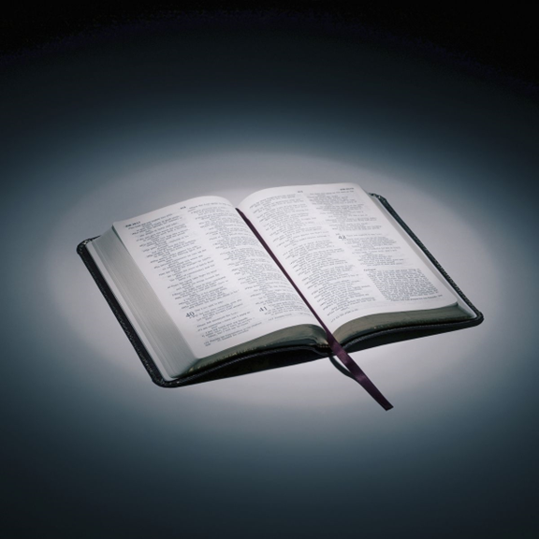
Bible reading

Slide 48
Judges 16:4-31 (NIV)
⁴ Some time later, he fell in love with a woman in the Valley of Sorek whose name was Delilah. ⁵ The rulers of the Philistines went to her and said, “See if you can lure him into showing you the secret of his great strength and how we can overpower him so we may tie him up and subdue him. Each one of us will give you eleven hundred shekels of silver.”

Slide 49
Judges 16:4-31 (NIV)
⁶ So Delilah said to Samson, “Tell me the secret of your great strength and how you can be tied up and subdued.”
⁷ Samson answered her, “If anyone ties me with seven fresh bowstrings that have not been dried, I’ll become as weak as any other man.”

Slide 50
Judges 16:4-31 (NIV)
⁸ Then the rulers of the Philistines brought her seven fresh bowstrings that had not been dried, and she tied him with them. ⁹ With men hidden in the room, she called to him, “Samson, the Philistines are upon you!” But he snapped the bowstrings as easily as a piece of string snaps when it comes close to a flame. So the secret of his strength was not discovered.

Slide 51
Judges 16:4-31 (NIV)
¹⁰ Then Delilah said to Samson, “You have made a fool of me; you lied to me. Come now, tell me how you can be tied.”
¹¹ He said, “If anyone ties me securely with new ropes that have never been used, I’ll become as weak as any other man.”

Slide 52
Judges 16:4-31 (NIV)
¹² So Delilah took new ropes and tied him with them. Then, with men hidden in the room, she called to him, “Samson, the Philistines are upon you!” But he snapped the ropes off his arms as if they were threads.
¹³ Delilah then said to Samson, “All this time you have been making a fool of me and lying to me. Tell me how you can be tied.”
He replied, “If you weave the seven braids of my head into the fabric on the loom and tighten it with the pin, I’ll become as weak as any other man.” So while he was sleeping, Delilah took the seven braids of his head, wove them into the fabric

Slide 53
Judges 16:4-31 (NIV)
¹⁴ and tightened it with the pin.
Again she called to him, “Samson, the Philistines are upon you!” He awoke from his sleep and pulled up the pin and the loom, with the fabric.
¹⁵ Then she said to him, “How can you say, ‘I love you,’ when you won’t confide in me? This is the third time you have made a fool of me and haven’t told me the secret of your great strength.”

Slide 54
Judges 16:4-31 (NIV)
¹⁶ With such nagging she prodded him day after day until he was sick to death of it.
¹⁷ So he told her everything. “No razor has ever been used on my head,” he said, “because I have been a Nazirite dedicated to God from my mother’s womb. If my head were shaved, my strength would leave me, and I would become as weak as any other man.”

Slide 55
Judges 16:4-31 (NIV)
¹⁸ When Delilah saw that he had told her everything, she sent word to the rulers of the Philistines, “Come back once more; he has told me everything.” So the rulers of the Philistines returned with the silver in their hands. ¹⁹ After putting him to sleep on her lap, she called for someone to shave off the seven braids of his hair, and so began to subdue him. And his strength left him.

Slide 56
Judges 16:4-31 (NIV)
²⁰ Then she called, “Samson, the Philistines are upon you!”
He awoke from his sleep and thought, “I’ll go out as before and shake myself free.” But he did not know that the Lord had left him.
²¹ Then the Philistines seized him, gouged out his eyes and took him down to Gaza. Binding him with bronze shackles, they set him to grinding grain in the prison.

Slide 57
Judges 16:4-31 (NIV)
²² But the hair on his head began to grow again after it had been shaved.
²³ Now the rulers of the Philistines assembled to offer a great sacrifice to Dagon their god and to celebrate, saying, “Our god has delivered Samson, our enemy, into our hands.”

Slide 58
Judges 16:4-31 (NIV)
²⁴ When the people saw him, they praised their god, saying,
“Our god has delivered our enemy
into our hands,
the one who laid waste our land
and multiplied our slain.”

Slide 59
Judges 16:4-31 (NIV)
²⁵ While they were in high spirits, they shouted, “Bring out Samson to entertain us.” So they called Samson out of the prison, and he performed for them.
When they stood him among the pillars, ²⁶ Samson said to the servant who held his hand, “Put me where I can feel the pillars that support the temple, so that I may lean against them.”

Slide 60
Judges 16:4-31 (NIV)
²⁷ Now the temple was crowded with men and women; all the rulers of the Philistines were there, and on the roof were about three thousand men and women watching Samson perform. ²⁸ Then Samson prayed to the Lord, “Sovereign Lord, remember me. Please, God, strengthen me just once more, and let me with one blow get revenge on the Philistines for my two eyes.”

Slide 61
Judges 16:4-31 (NIV)
²⁹ Then Samson reached toward the two central pillars on which the temple stood. Bracing himself against them, his right hand on the one and his left hand on the other, ³⁰ Samson said, “Let me die with the Philistines!” Then he pushed with all his might, and down came the temple on the rulers and all the people in it. Thus he killed many more when he died than while he lived.

Slide 62
Judges 16:4-31 (NIV)
³¹ Then his brothers and his father’s whole family went down to get him. They brought him back and buried him between Zorah and Eshtaol in the tomb of Manoah his father. He had led Israel twenty years.

Slide 63
Scripture quotations taken from The Holy Bible, New International Version® NIV®
Copyright © 1973, 1978, 1984, 2011 by Biblica, Inc.
Used with permission. All rights reserved worldwide.

Slide 64
Announcements

Slide 65





Account name: Blacktown Chinese Christian Church
Account number: 4216 50263
Offering
BSB: 112 - 879
Please put in "offering" as the reference
The offering box is available at the back of the hall

Slide 66
Prayer points

Slide 67
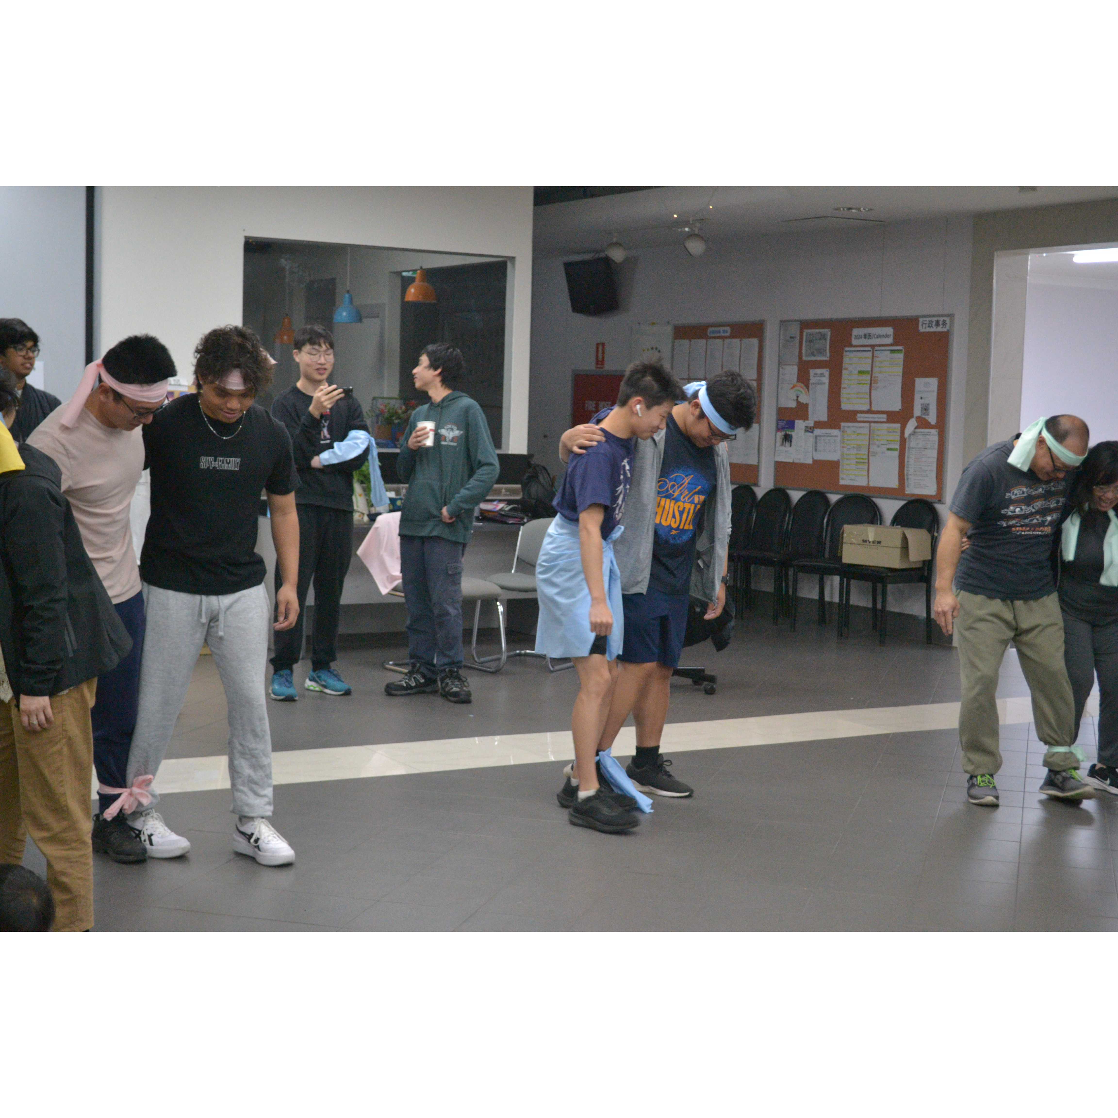
Mingle time!

